Slide 1

Introduction To machine learning, deep learning, and The neural networks.
Tashik Moin Gold ambassador, mct.

Slide 2
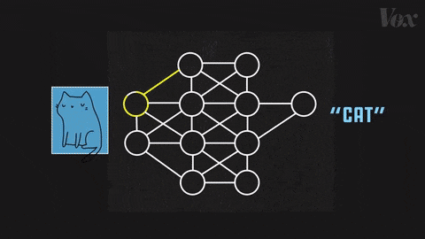
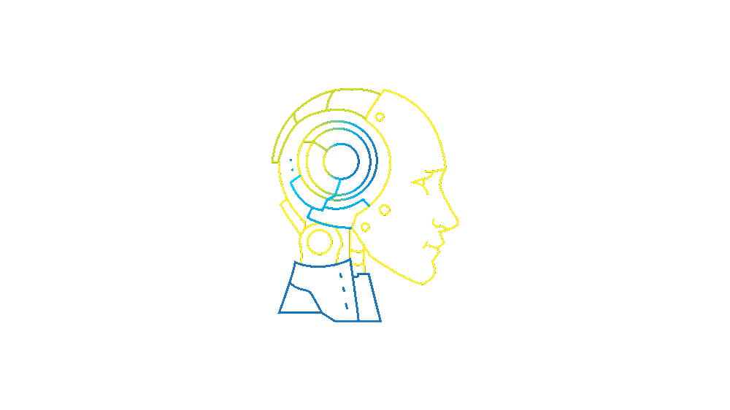
Contents to be covered
- Introduction to Machine Learning, and Deep Learning. - Artificial Neural Networks (ANN). - Convolutional Neural Networks (CNN). - Recurrent Neural Networks (RNN). - Long Short-term Memory (LSTM). - Gated Recurrent Unit (GRU).

Slide 3
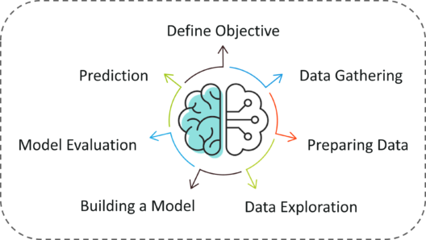
Machine Learning
“In classic terms, machine learning is a type of artificial intelligence that enables self-learning from data and then applies that learning without the need for human intervention. In actuality, there are many different types of machine learning, as well as many strategies of how to best employ them.”

Slide 4
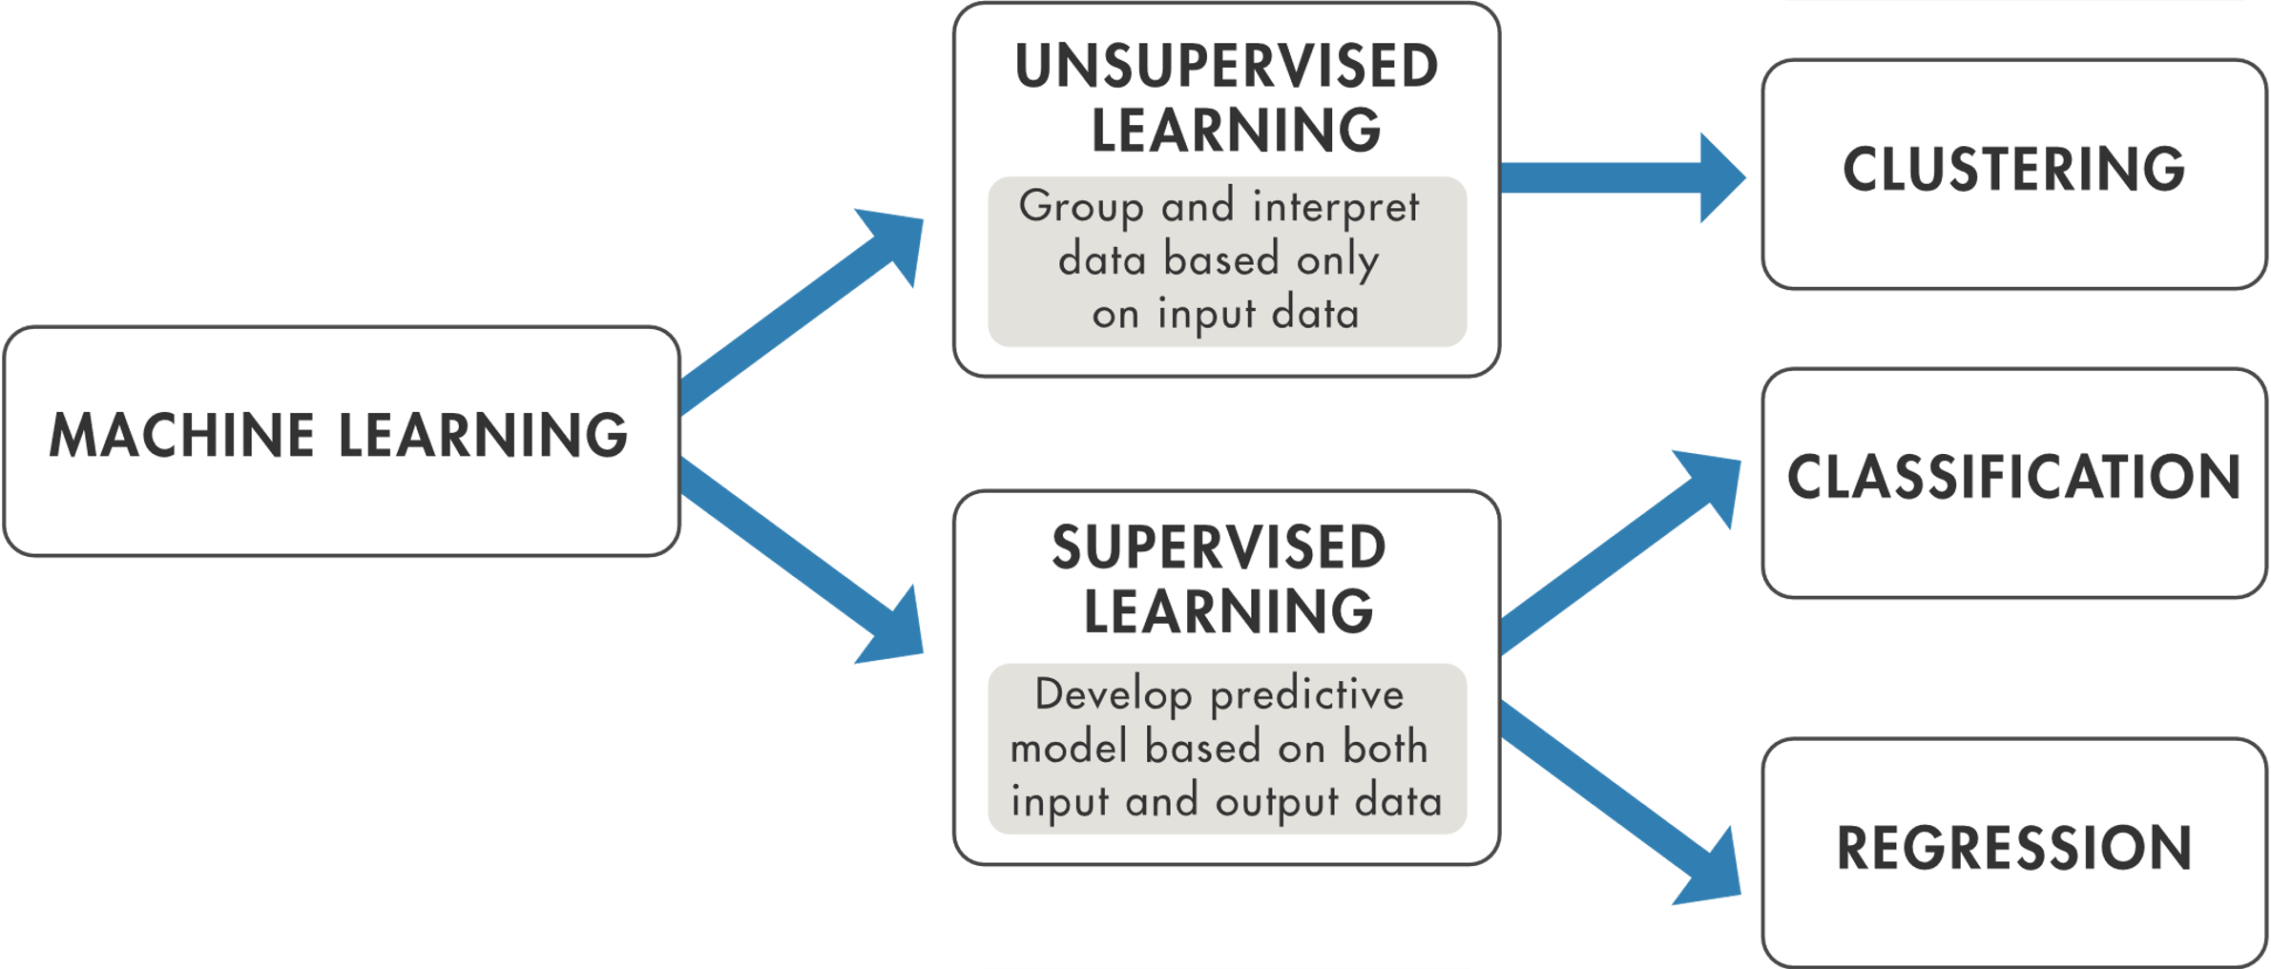
Types of Machine Learning

Slide 5
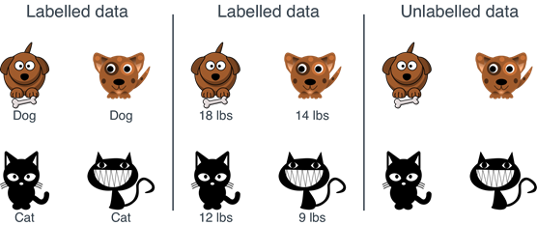
Labelled and unlabeled data

Slide 6
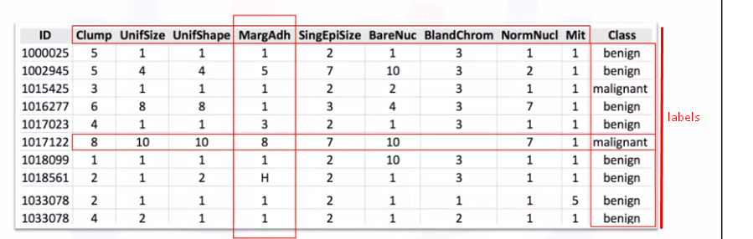

Slide 7
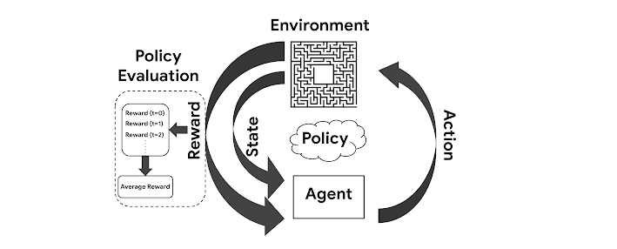
reinforcement Learning
Reinforcement learning is another type of machine learning and it is an area of machine learning concerned with how intelligent agents ought to take actions in an environment in order to maximize the notion of cumulative reward. Reinforcement learning is one of three basic machine learning paradigms, alongside supervised learning and unsupervised learning.

Slide 8
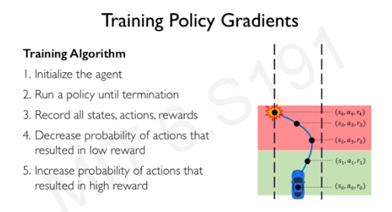
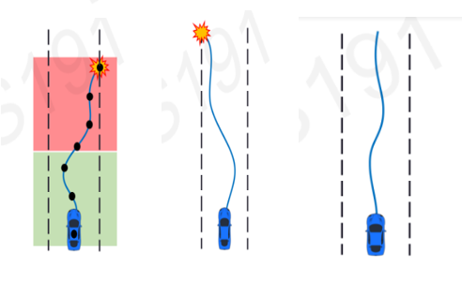

Slide 9
deep Learning
A type of machine learning based on artificial neural networks in which multiple layers of processing are used to extract progressively higher level features from data. In deep learning, both Feature extraction as well as classification both is done by the machine itself whereas in machine learning, feature extraction is done by us and not by the machine.

Slide 10
Machine Learning vs deep learning
Supervised learning requires programmers to design and predefine features manually, which are used to represent the data in a numerical way. For example, we can represent a cat with three features such as the eyes, the legs, the nose, etc. A vector of numbers like [6, 2, 8 …] can represent the image of this cat. In this scenario, the feature is extracted by programmers, because they have knowledge about this cat image. However, instead of manually selecting the features, deep learning learns the features automatically.

Slide 11
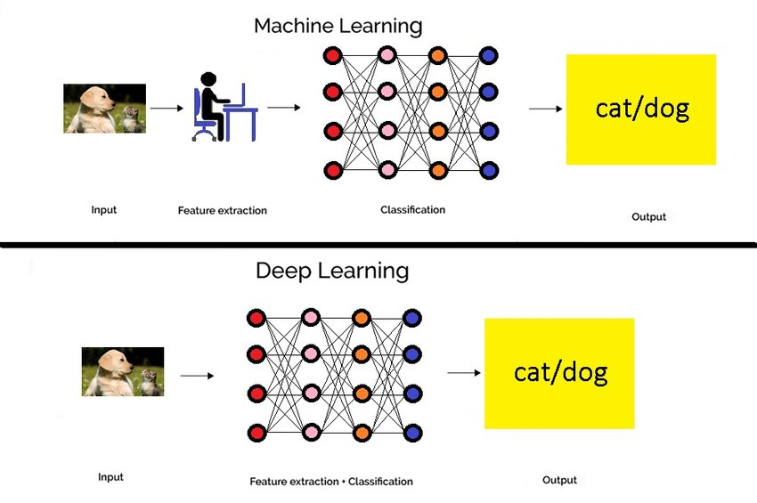

Slide 12
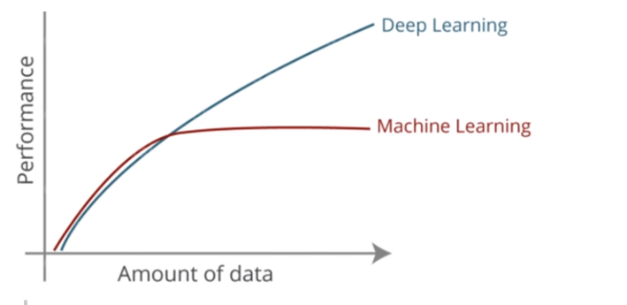

Slide 13
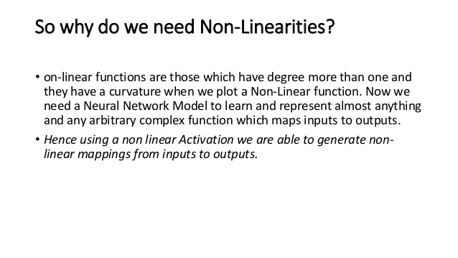

Slide 14
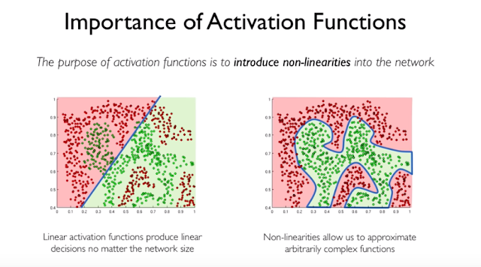

Slide 15
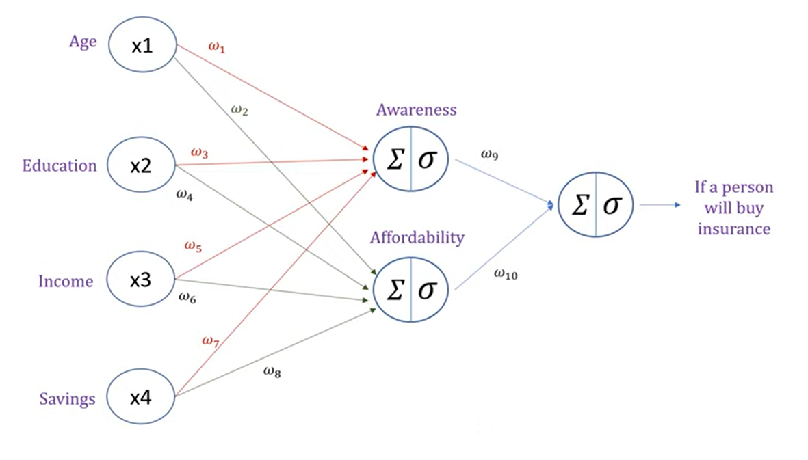
Artificial neural network (ANN)

Slide 16
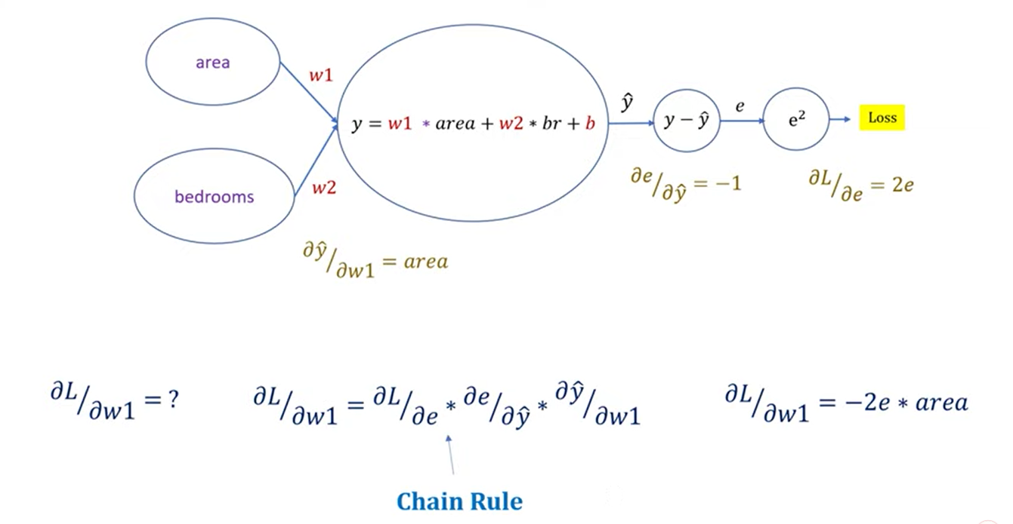
The chain rule

Slide 17
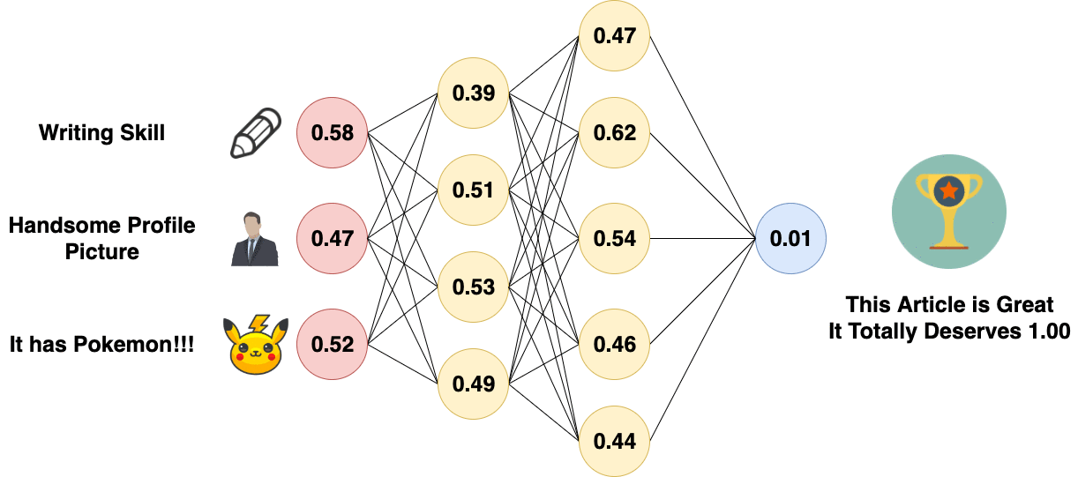
backpropagation

Slide 18
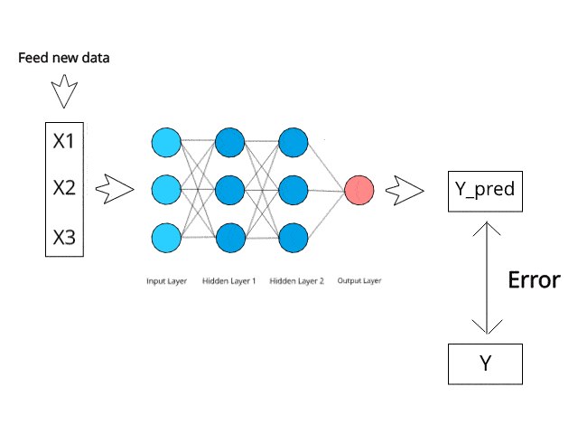

Slide 19
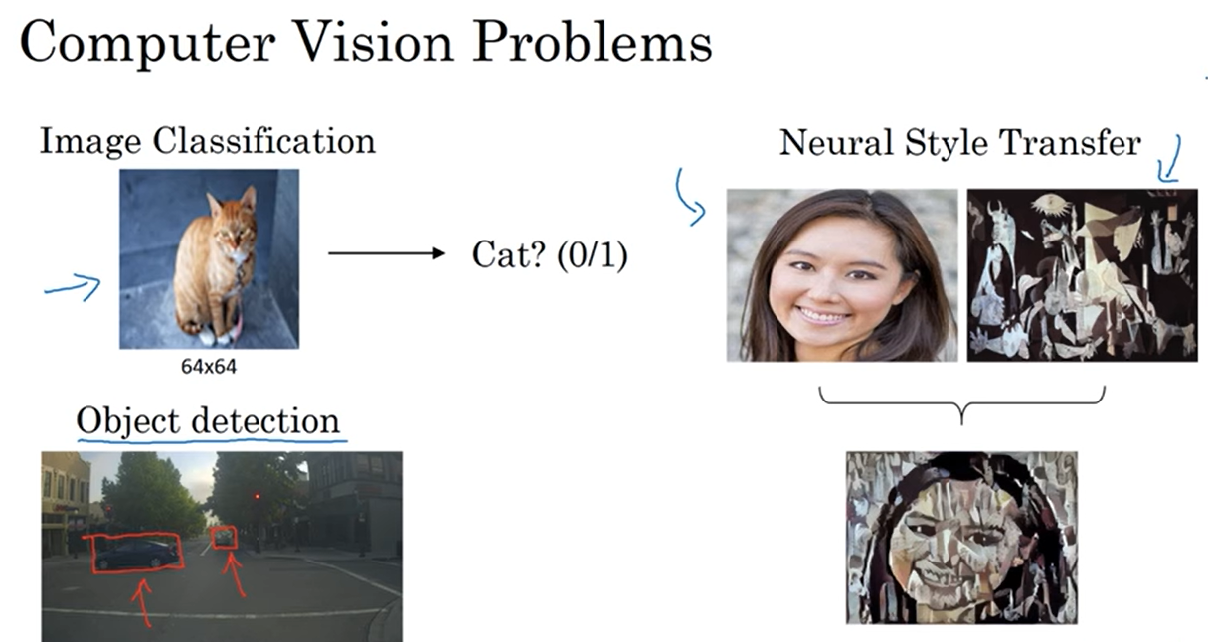
Convolutional neural networks (CNN)
Convolutional Neural Networks, or CNNs, were designed to map image data to an output variable. They have proven so effective that they are the go-to method for any type of prediction problem involving image data as an input.

Slide 20
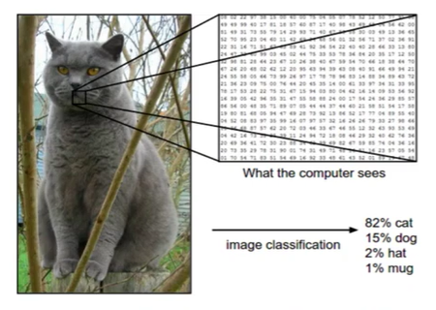

Slide 21
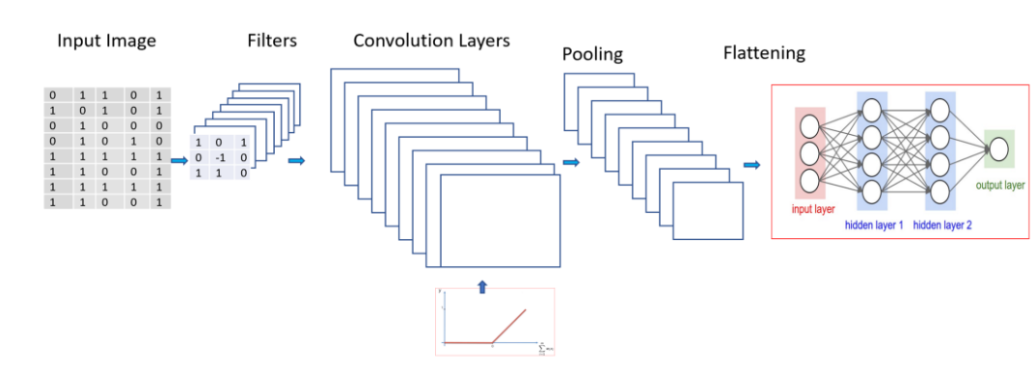

Slide 22
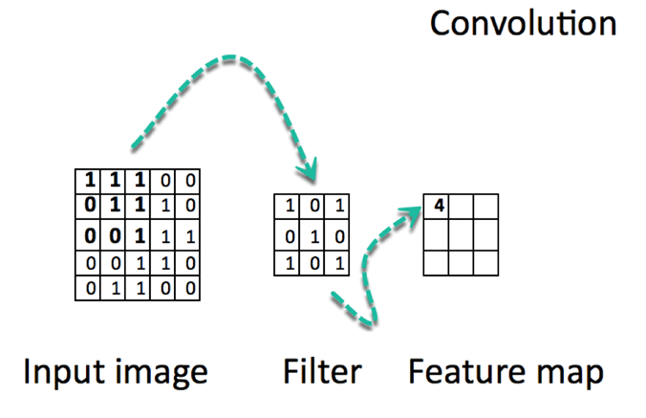

Slide 23
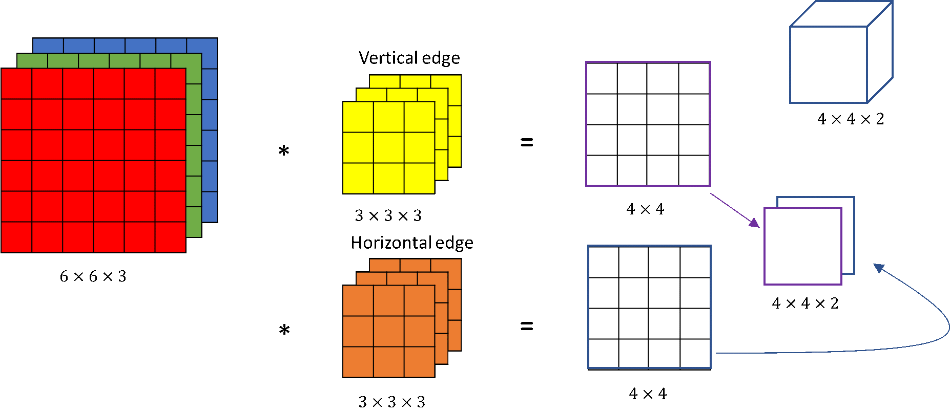

Slide 24
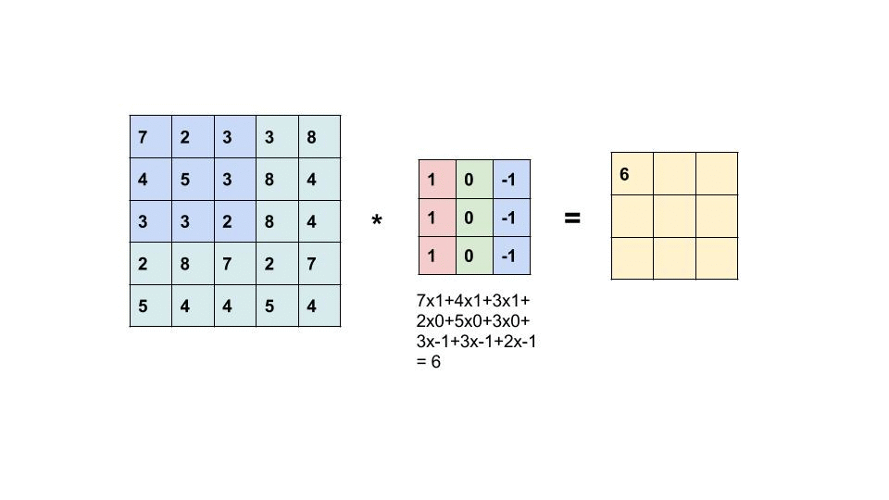


Slide 25
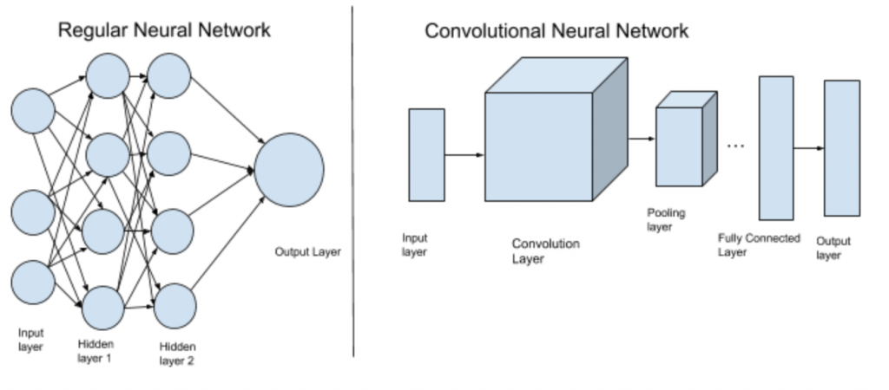
ANN vs CNN

Slide 26


Slide 27
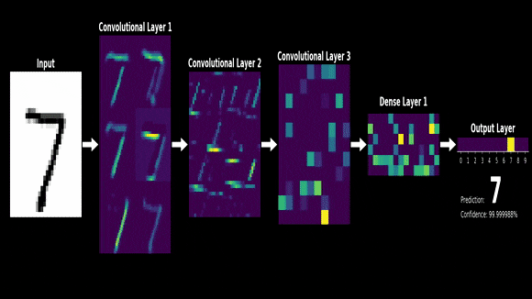

Slide 28
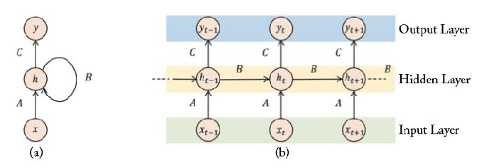
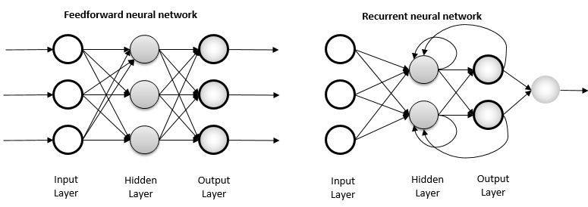
Recurrent neural network
Feedforward neural networks pass the data forward from input to output, while recurrent networks have a feedback loop where data can be fed back into the input at some point (self-loops in hidden layers, same hidden layer’s neurons can feed inputs/outputs to each other) before it is fed forward again for further processing and final output.

Slide 29
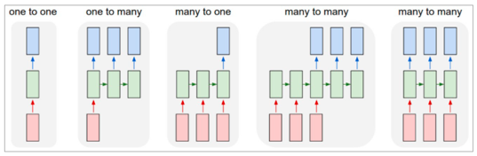
What makes Recurrent Networks so special?
A glaring limitation of Vanilla Neural Networks (and also Convolutional Networks) is that their API is too constrained: they accept a fixed-sized vector as input (e.g., an image) and produce a fixed-sized vector as output (e.g., probabilities of different classes). Not only that: These models perform this mapping using a fixed number of computational steps (e.g., the number of layers in the model). The core reason that recurrent nets are more exciting is that they allow us to operate over sequences of vectors: Sequences in the input, the output, or in the most general case both and it has a short-term memory that other neural networks like ANN and CNN does not have.

Slide 30
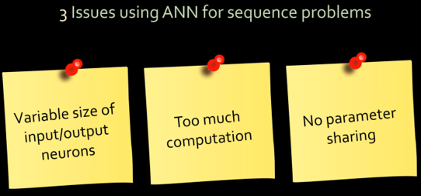

Slide 31
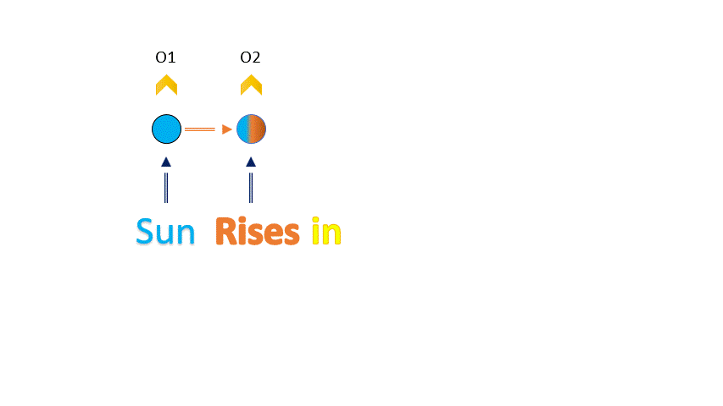
Problems with rnn
Vanishing Gradient Problem As number of hidden layers grow, the gradient becomes very small and the weights will hardly change. This will hamper the learning process. Tashik likes to play cricket,..... it shouldn’t be hard to guess that he is from Pakistan. (Hard to predict long sentences)

Slide 32


Slide 33
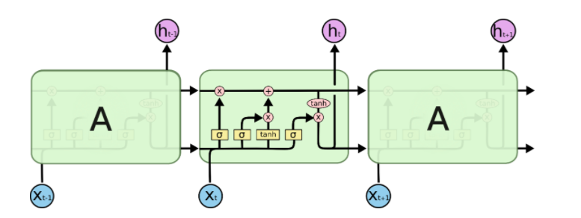
Long short-term memory (LSTM)
Long Short-Term Memory (LSTM) networks are a type of recurrent neural network capable of learning order dependence in sequence prediction problems. This is a behavior required in complex problem domains like machine translation, speech recognition, and more. LSTMs are a complex area of deep learning.

Slide 34
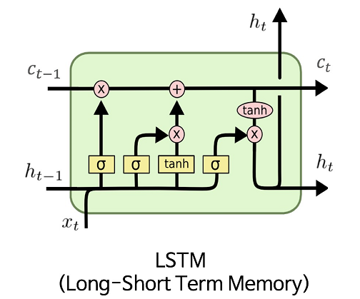
Tashik likes to play cricket,..... it shouldn’t be hard to guess that he is from Pakistan. (Easy to predict long sentences with long term memory) Ct → Long-term Memory Ht → Short-term Memory

Slide 35
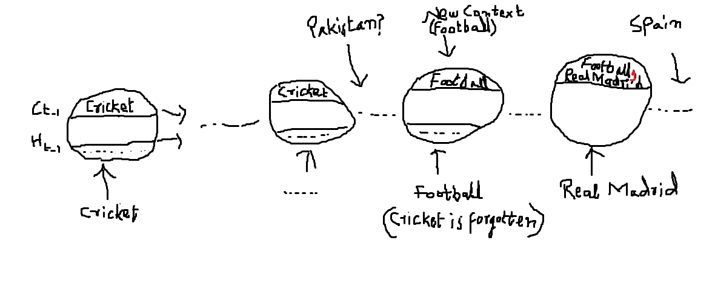
What if the context is changed?
Tashik likes to play cricket,..... it shouldn’t be hard to guess that he is from Pakistan. But, his friend David likes to play football,….. It shouldn’t be hard to guess that he is from Spain.

Slide 36
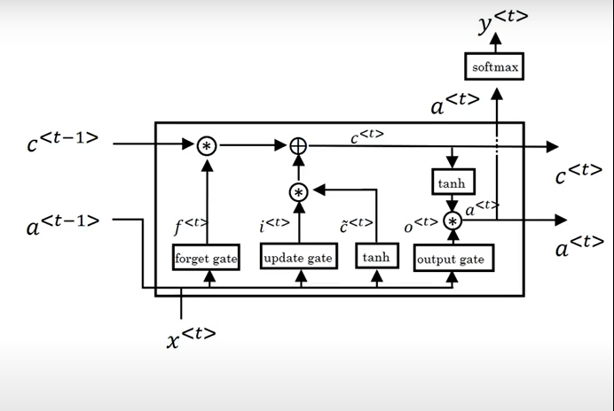
Forget, input/update, and output gates

Slide 37


Slide 38
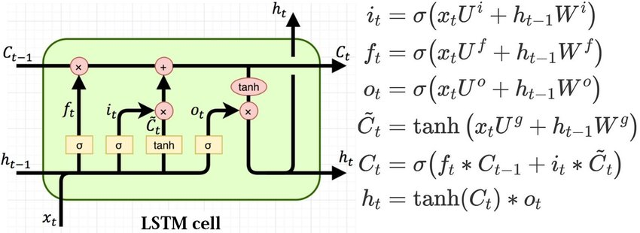

Slide 39
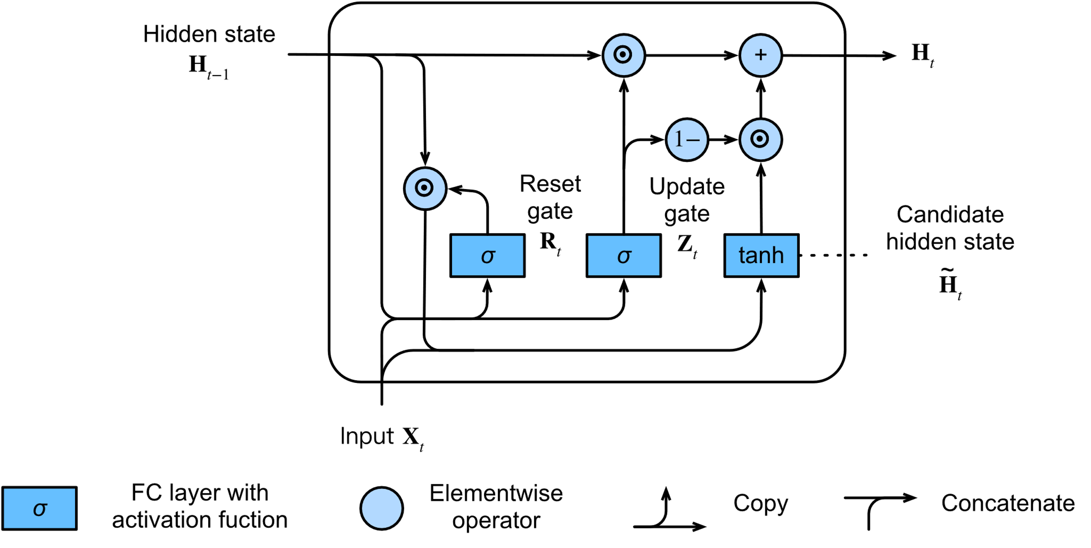
Gated recurrent units (GRU)
The GRU is like a long short-term memory with a forget gate, but has fewer parameters than LSTM, as it lacks an output gate.

Slide 40
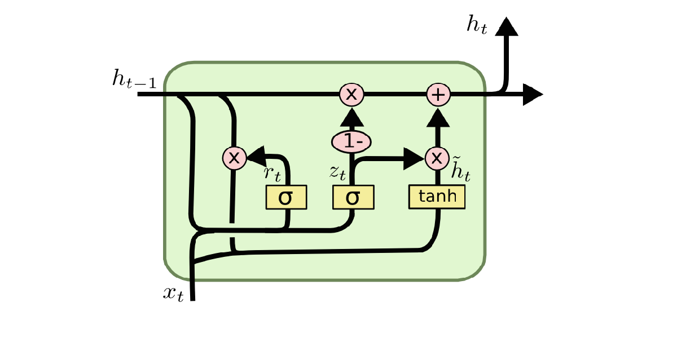
Update, Reset Gates

Slide 41
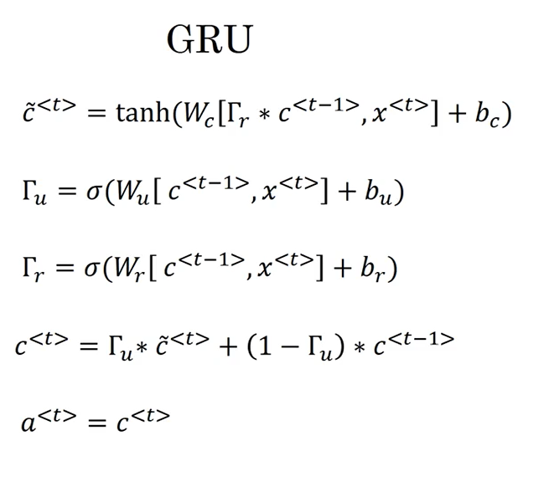

Slide 42
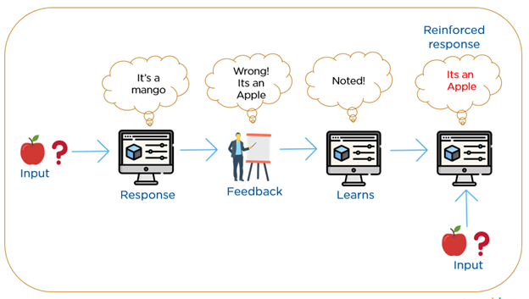
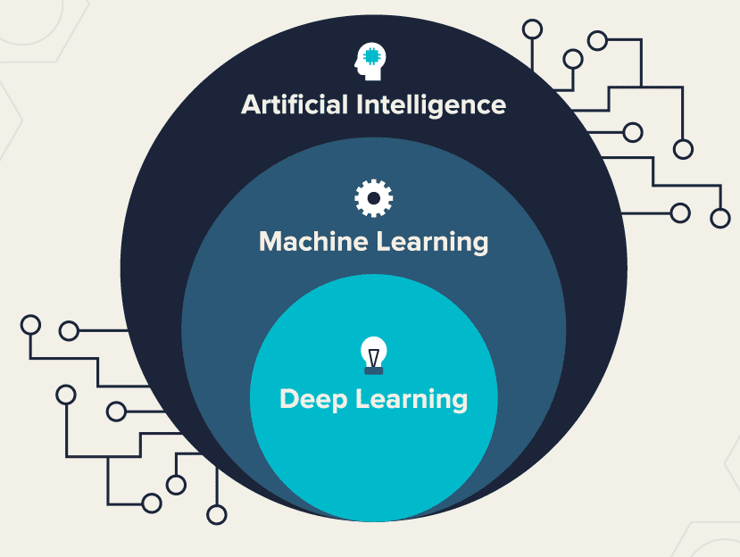
Thank You

